Slide 1
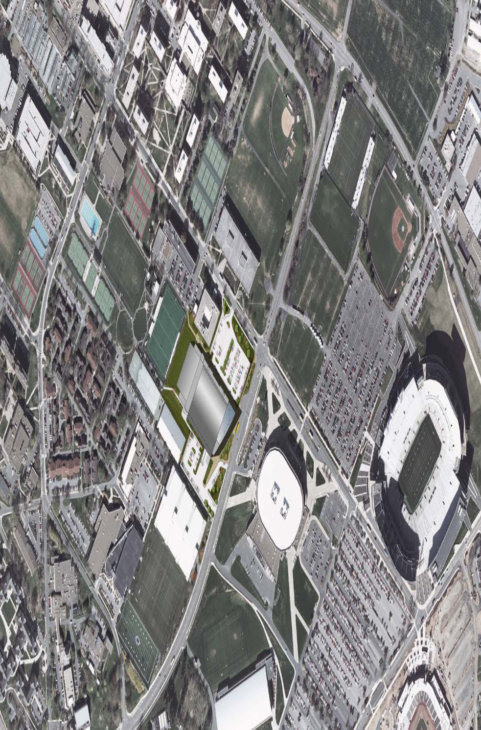
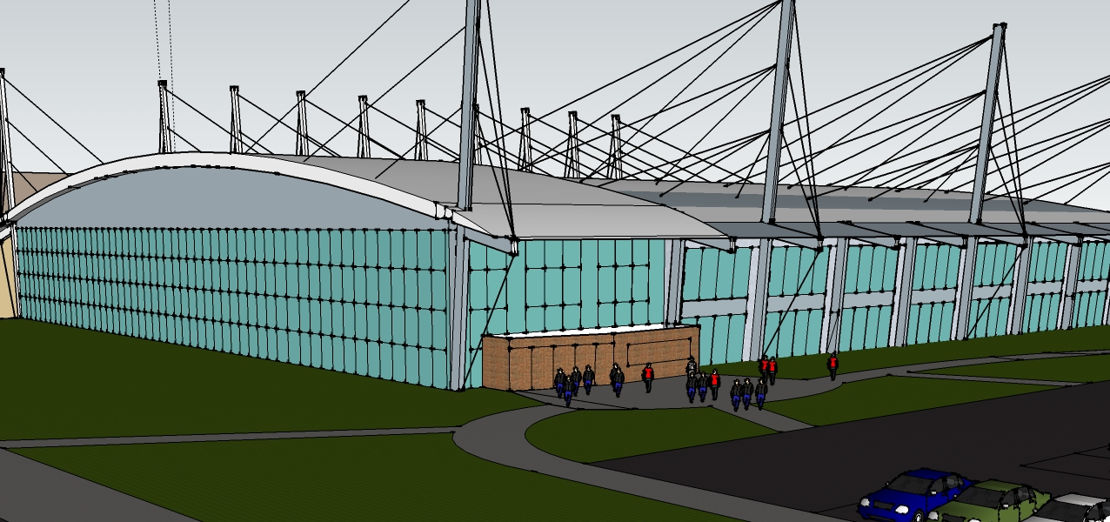

  Mission Statement:
  To deliver innovative designs, with an integrated, streamlined approach to building systems and construction management
Nate Babyak Alex Ho Brian Sampson Alex Schreffler

Slide 2
Agenda
Roof Analysis/Redesign
New Mechanical Loft Addition
Lobby Analysis/Redesign
Moving Forward
Nate Babyak Alex Ho Brian Sampson Alex Schreffler

Slide 3
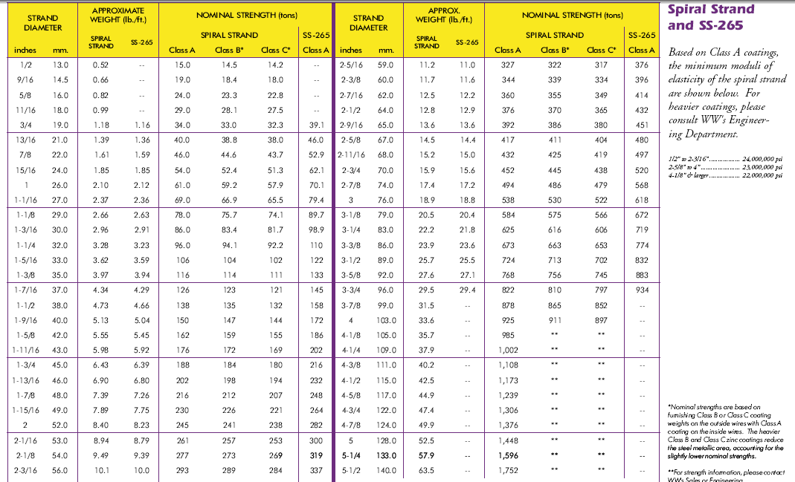
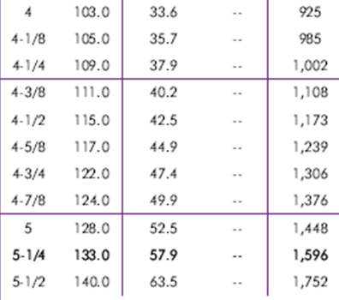
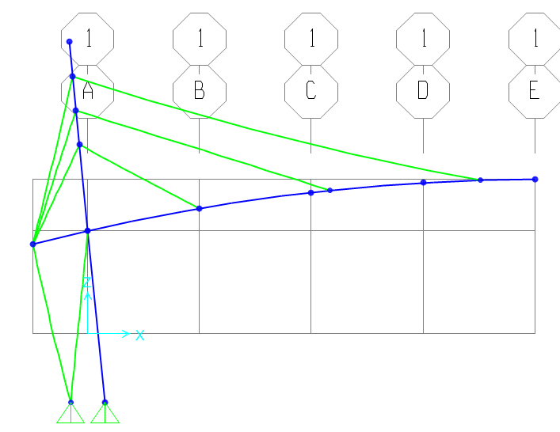
Design Considerations
Cable Stay Roof Design
Dead loads
  Roof Deck
  Roof Members
Snow Loads
  Unbalanced Drift
Wind Uplift
Cable Load Combinations
ASCE 7 Load Combinations
Erection Sequencing
Nate Babyak Alex Ho Brian Sampson Alex Schreffler

Slide 4
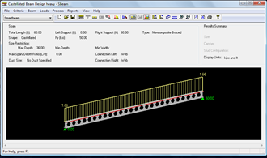
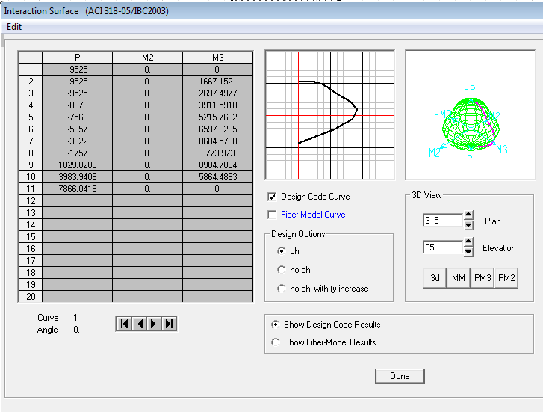
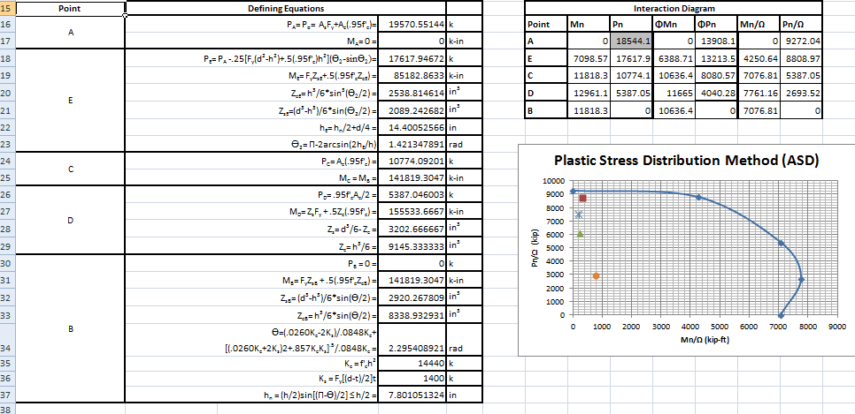
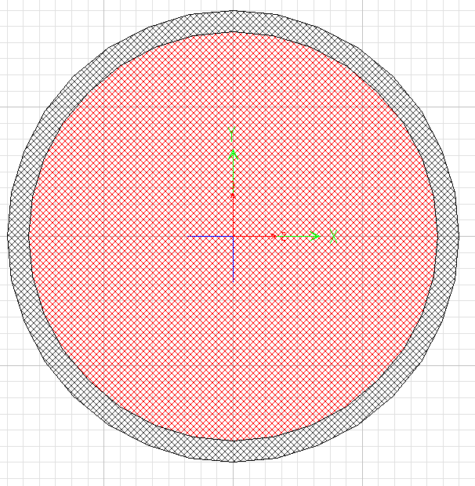
Design Attempts
Cable Stay Roof Design
First Attempt:
Deck: 3N18 spanning 14’
Beams:
  W30x90
  CB 36x55 (CMC Steel Products)
Girder:
  W40x372
Cables: Diameters 4.25” to 5.5”
Mast:
  Composite Column Design
  36” steel pipe 1.5” thick 8 ksi concrete
Nate Babyak Alex Ho Brian Sampson Alex Schreffler

Slide 5
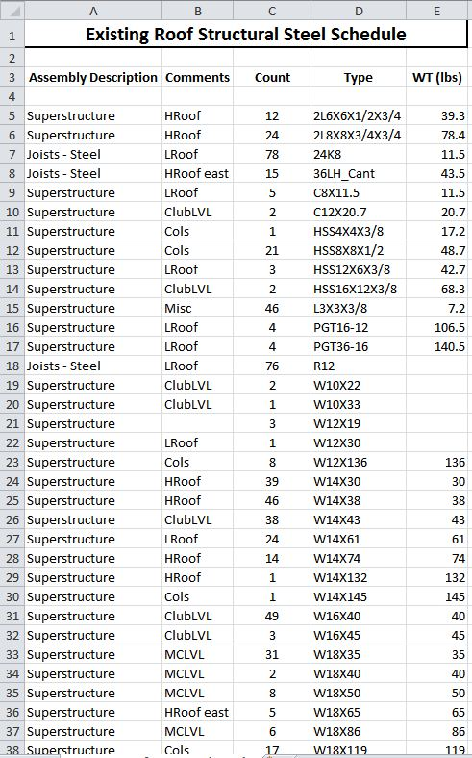
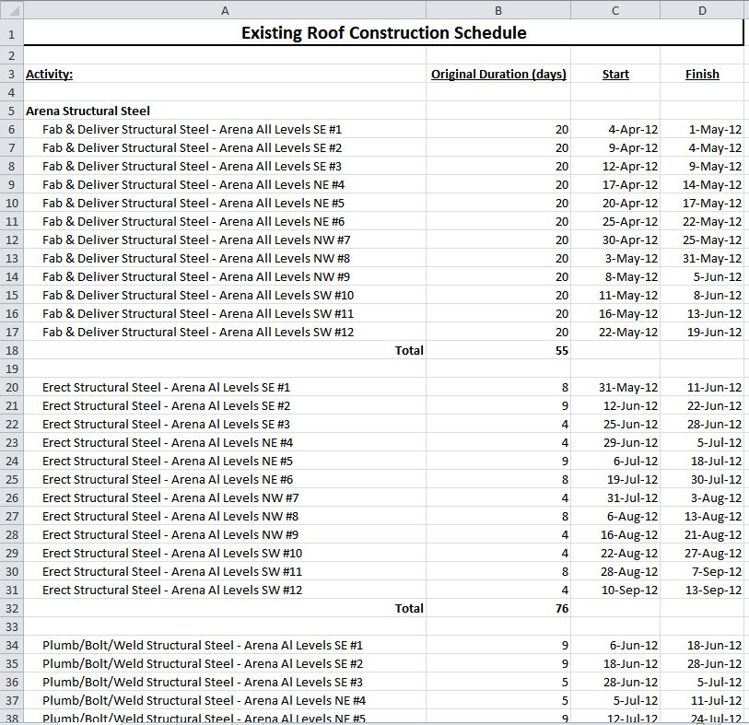
Design Attempts
Cable Stay Roof Design
Second Attempt:
Deck: 3C18 spanning 11’
Beams:
  W33x130
  CB 36x94 (CMC Steel Products)
Girder:
  W40x593
Cables: Diameters 4” to 5.5”
Mast:
  Composite Column Design
  42” steel pipe 2” thick 10 ksi concrete
Nate Babyak Alex Ho Brian Sampson Alex Schreffler

Slide 6
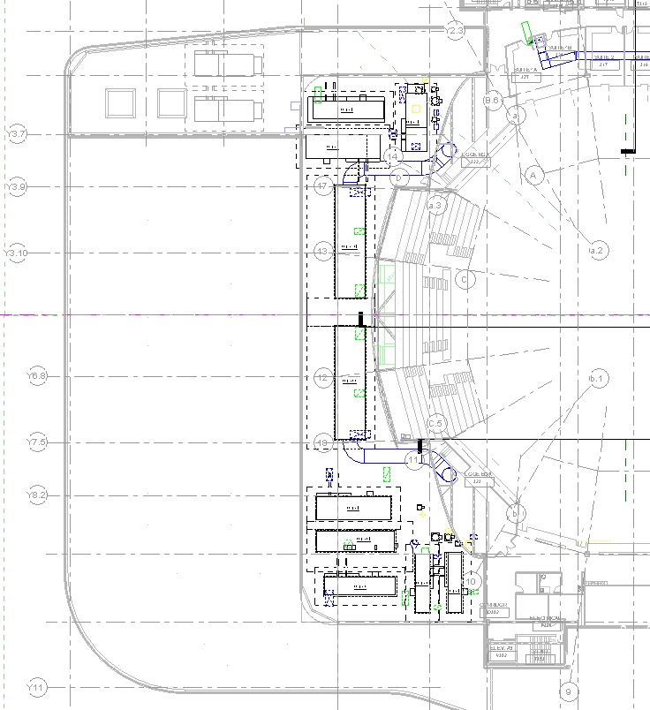
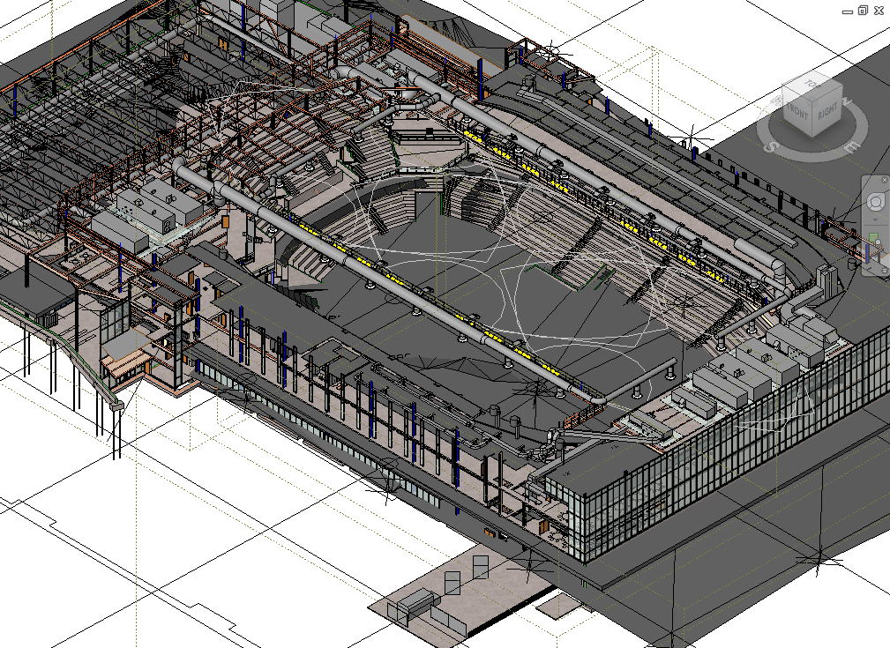
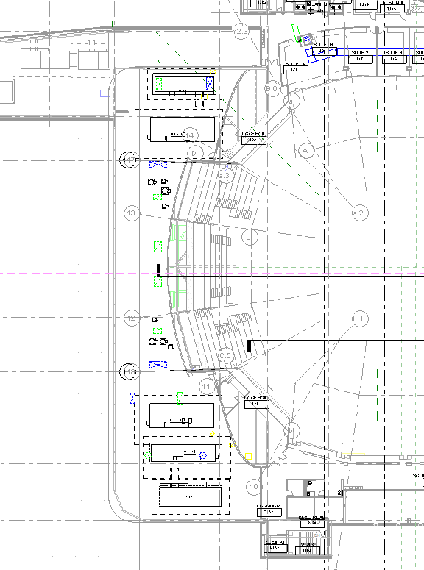
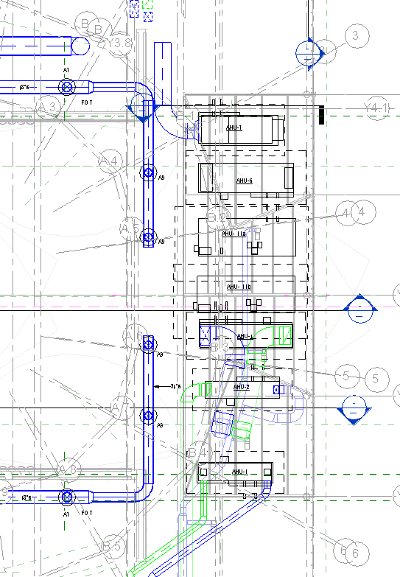
Baseline Mechanical Space
Mechanical Space and Loft Redesign
3D Coordination
Nate Babyak Alex Ho Brian Sampson Alex Schreffler

Slide 7
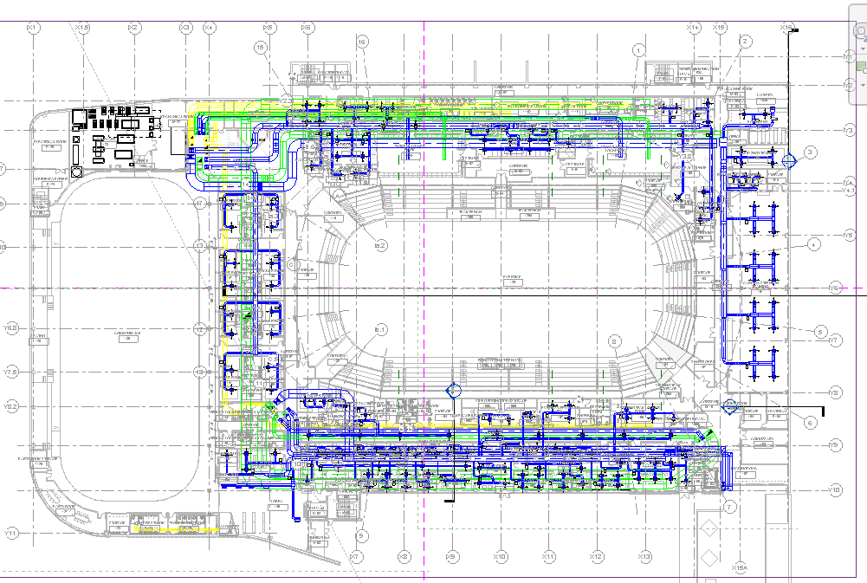
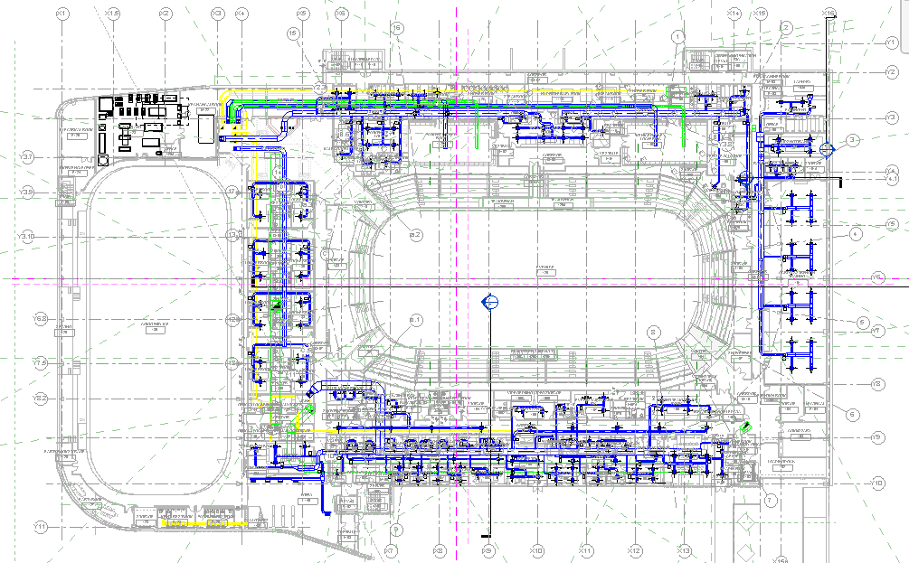
Baseline Event Level Ductwork Layout
Event Level Ductwork Layout Redesign
Event Level Ductwork Reduction
Nate Babyak Alex Ho Brian Sampson Alex Schreffler

Slide 8
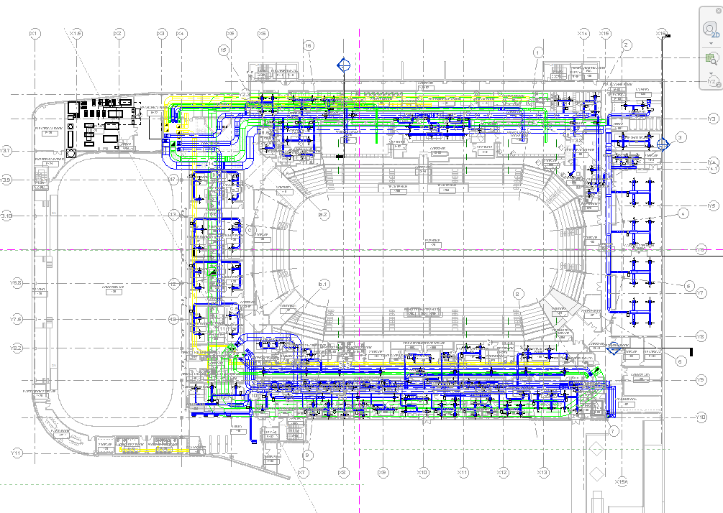
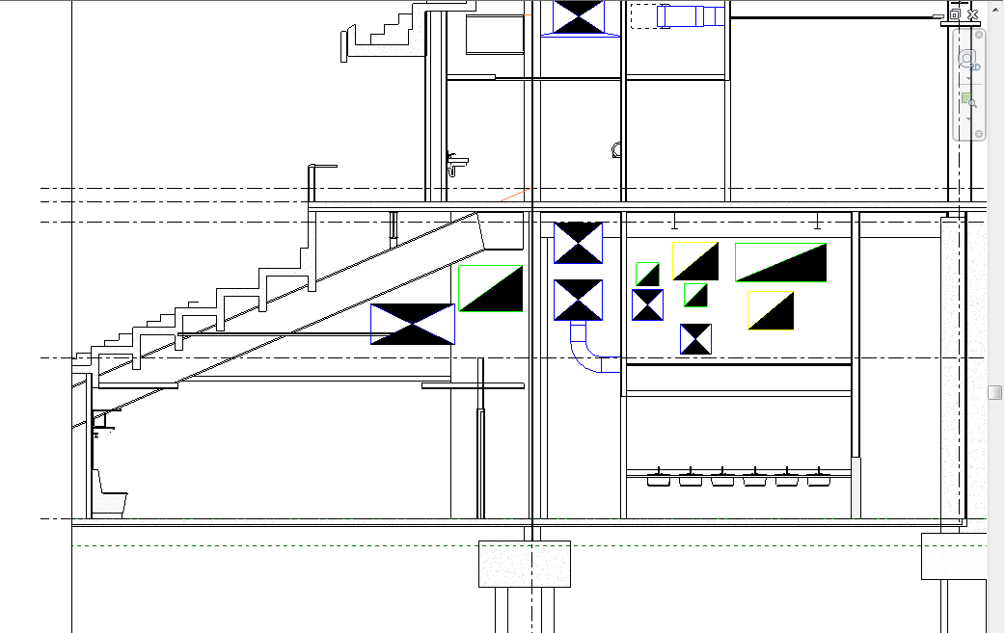
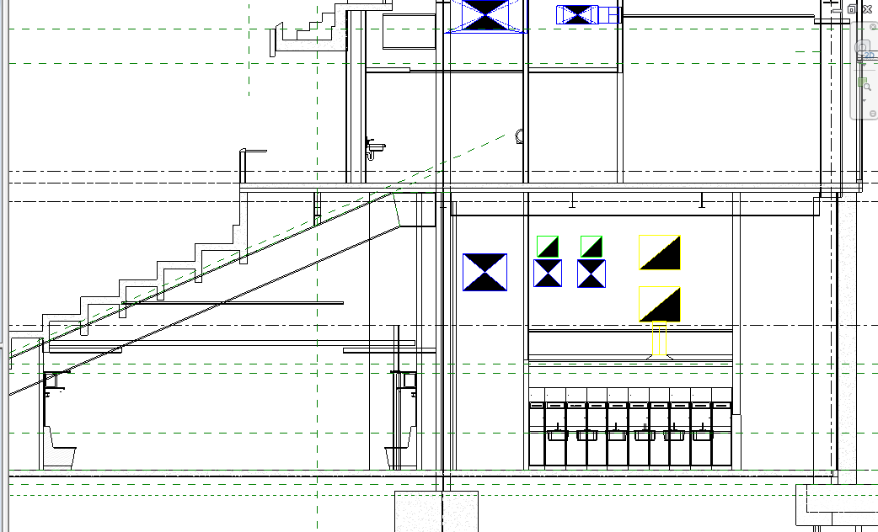
Baseline Event Level Ductwork Layout
Baseline North Concourse Section
Redesign North Concourse Section
Nate Babyak Alex Ho Brian Sampson Alex Schreffler

Slide 9
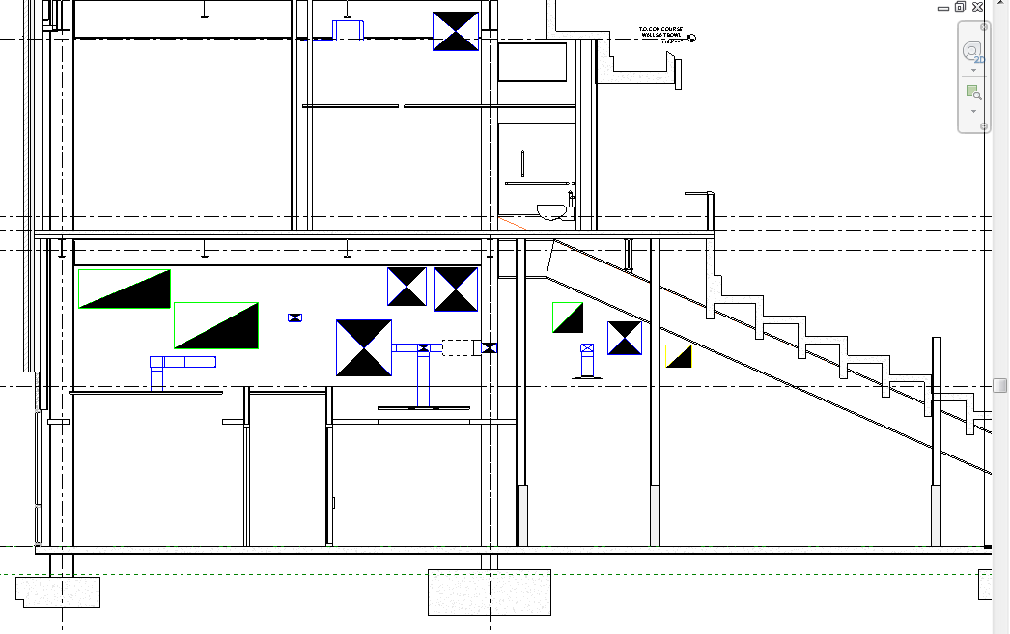
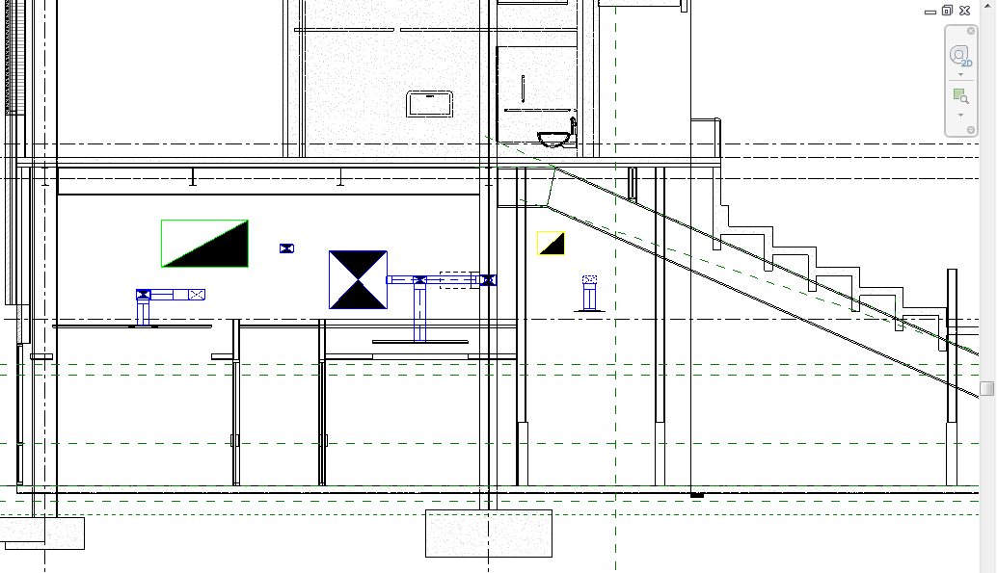
Baseline Event Level Ductwork Layout
Baseline South Concourse Section
Redesign South Concourse Section
Nate Babyak Alex Ho Brian Sampson Alex Schreffler

Slide 10
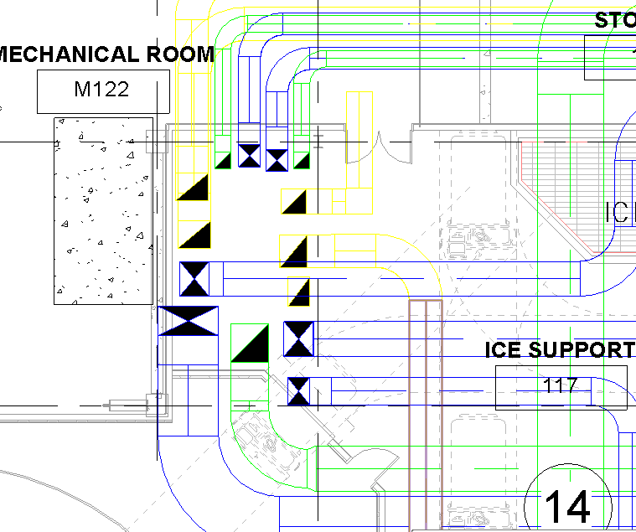
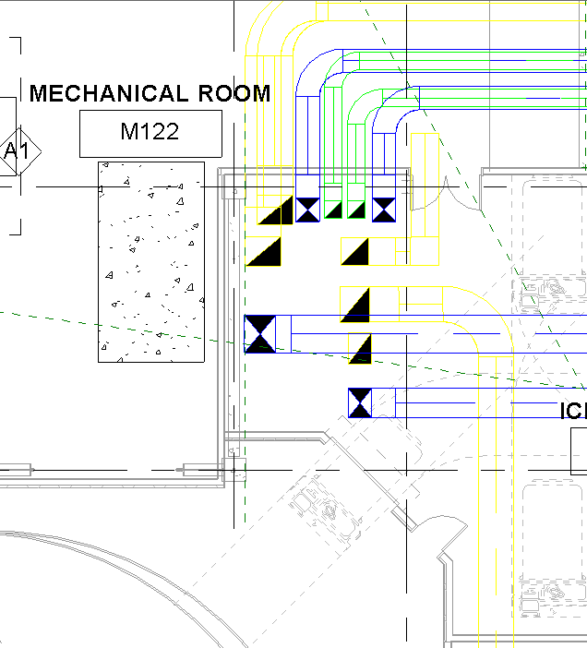
Baseline Event Level Ductwork Layout
Baseline Shaft 1
Redesign Shaft 1
Nate Babyak Alex Ho Brian Sampson Alex Schreffler

Slide 11
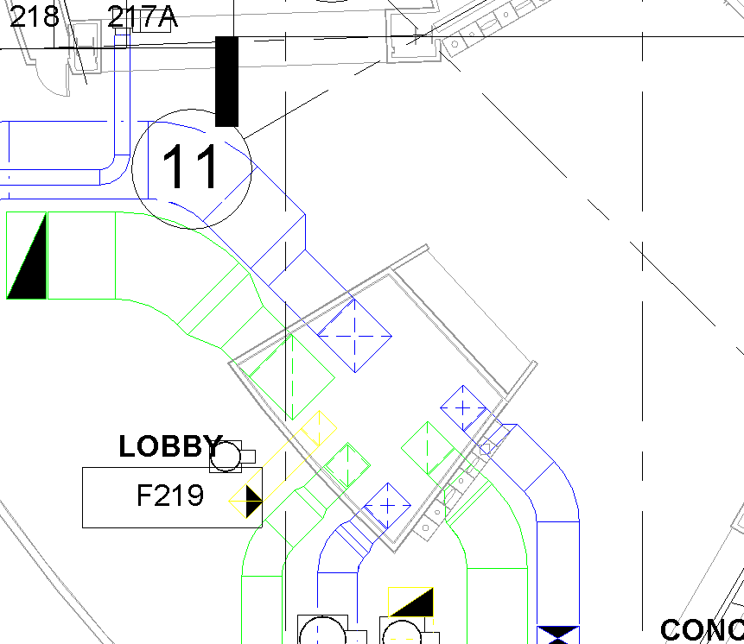
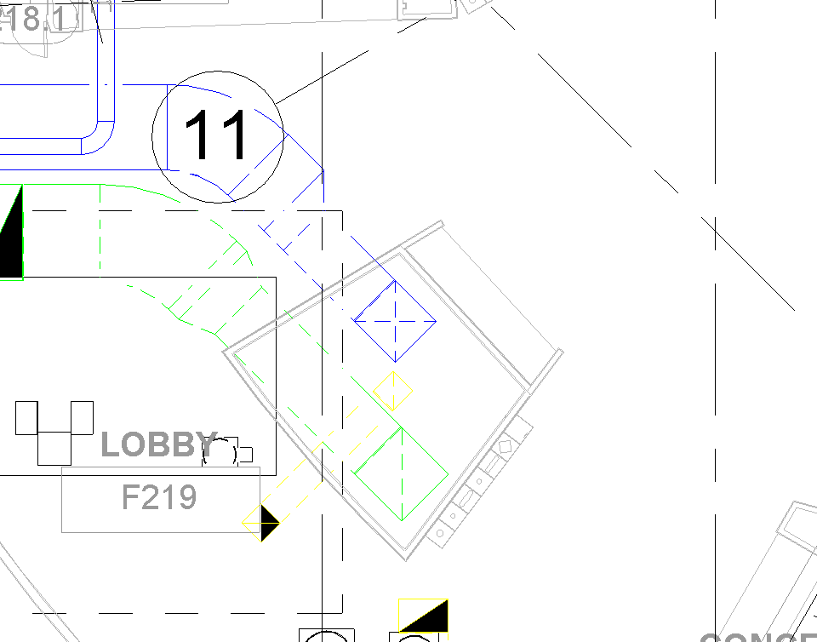
Baseline Event Level Ductwork Layout
Baseline Shaft 2
Redesign Shaft 2
Nate Babyak Alex Ho Brian Sampson Alex Schreffler

Slide 12
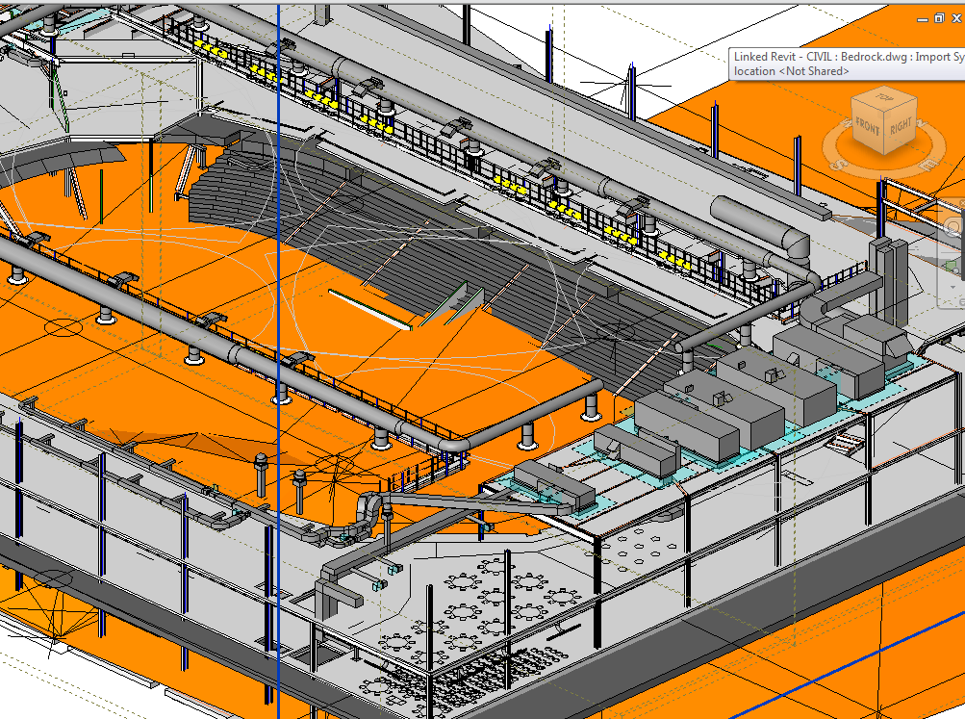
Shaft Locations and Redesign
Nate Babyak Alex Ho Brian Sampson Alex Schreffler

Slide 13
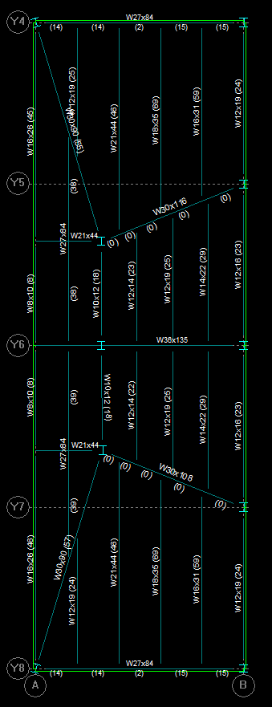
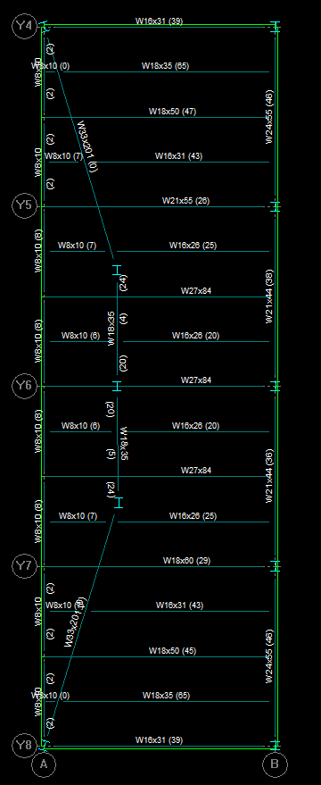
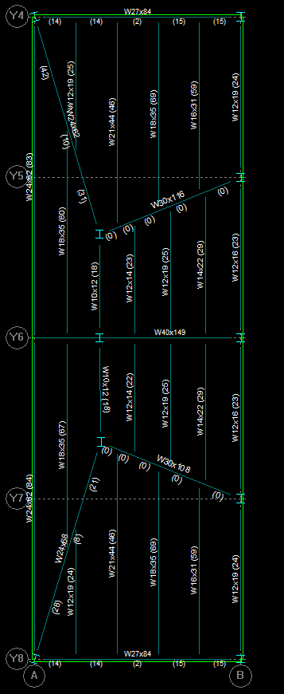
Loft Framing
Weight of Steel: 67,777 lbs
Weight of Steel: 65,476 lbs
Weight of Steel: 66,671 lbs
Nate Babyak Alex Ho Brian Sampson Alex Schreffler

Slide 14
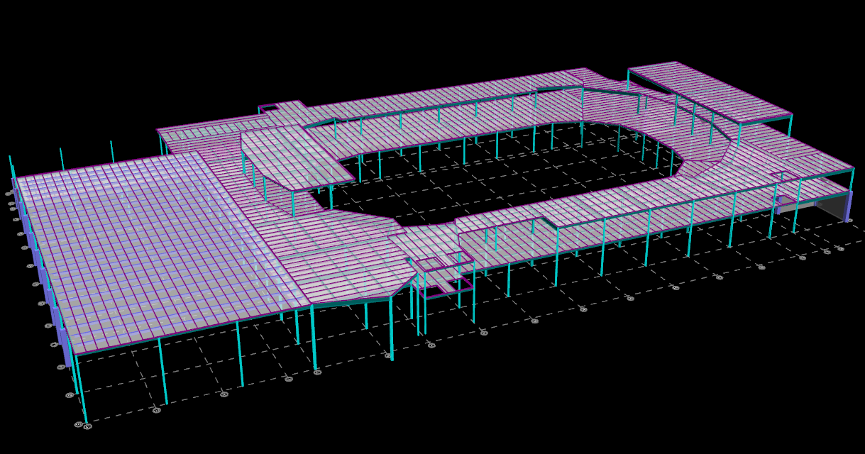
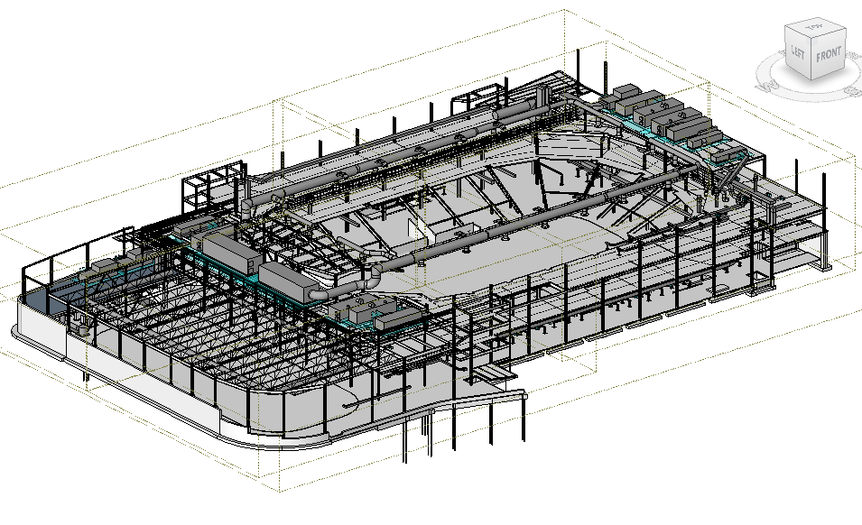
Structural Framing
Bay Size Change
Maintain Floor Deck
Coordinating Shaft Locations
Coordinating with Architecture
Nate Babyak Alex Ho Brian Sampson Alex Schreffler

Slide 15
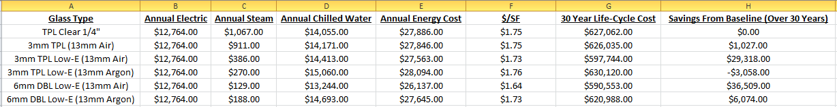
East Façade Glass Type
  Balance between thermal gain and daylight levels
  Insulated/Low-E

Slide 16
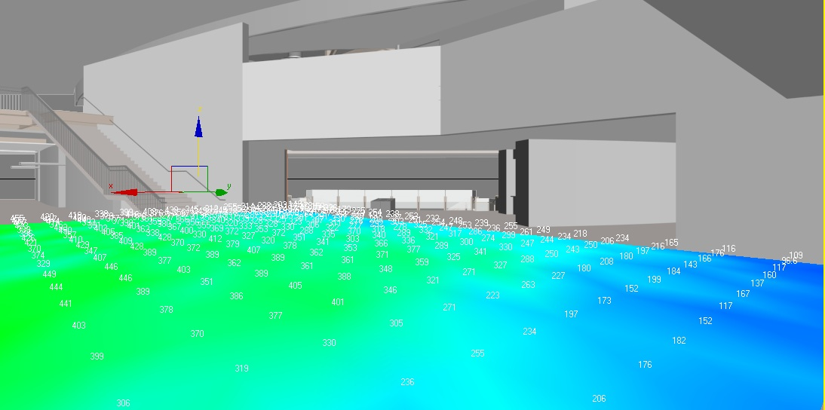
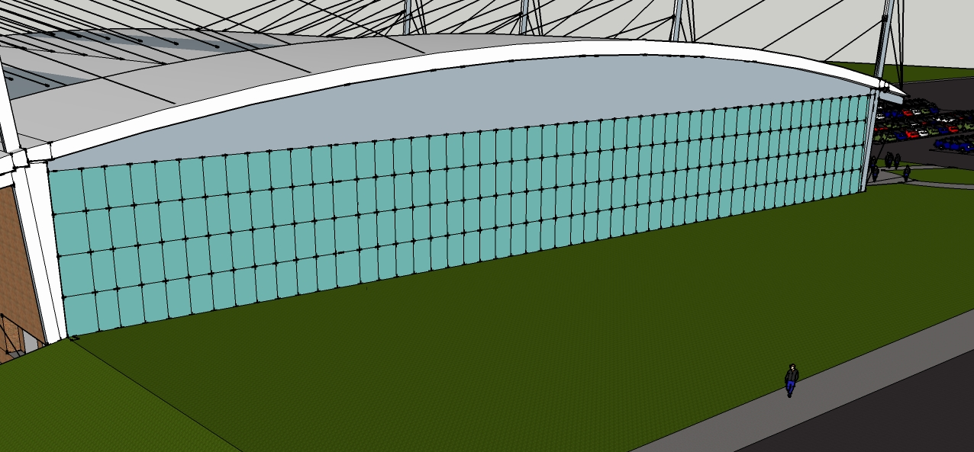
Shading: Un-shaded
Average Illuminance Level: 400 fc
East Façade Yearly Energy Costs: $27,529.00
Nate Babyak Alex Ho Brian Sampson Alex Schreffler

Slide 17
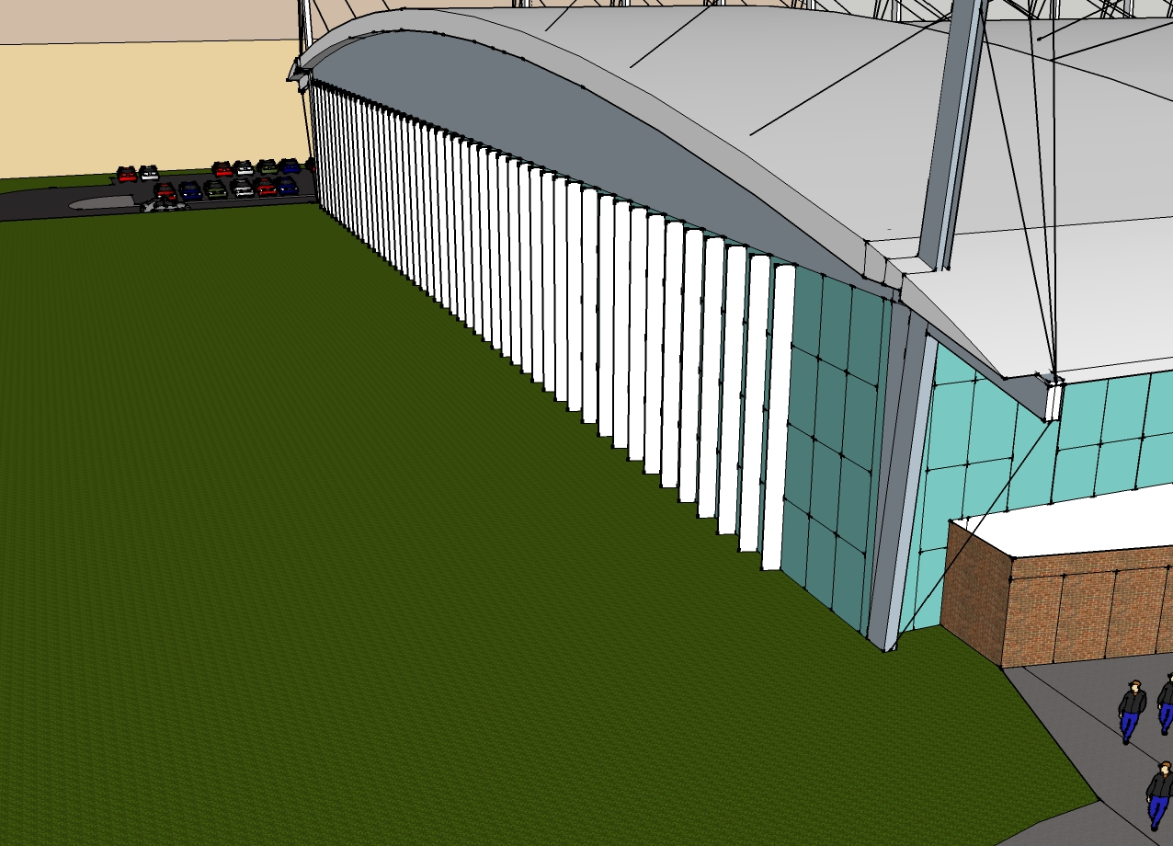
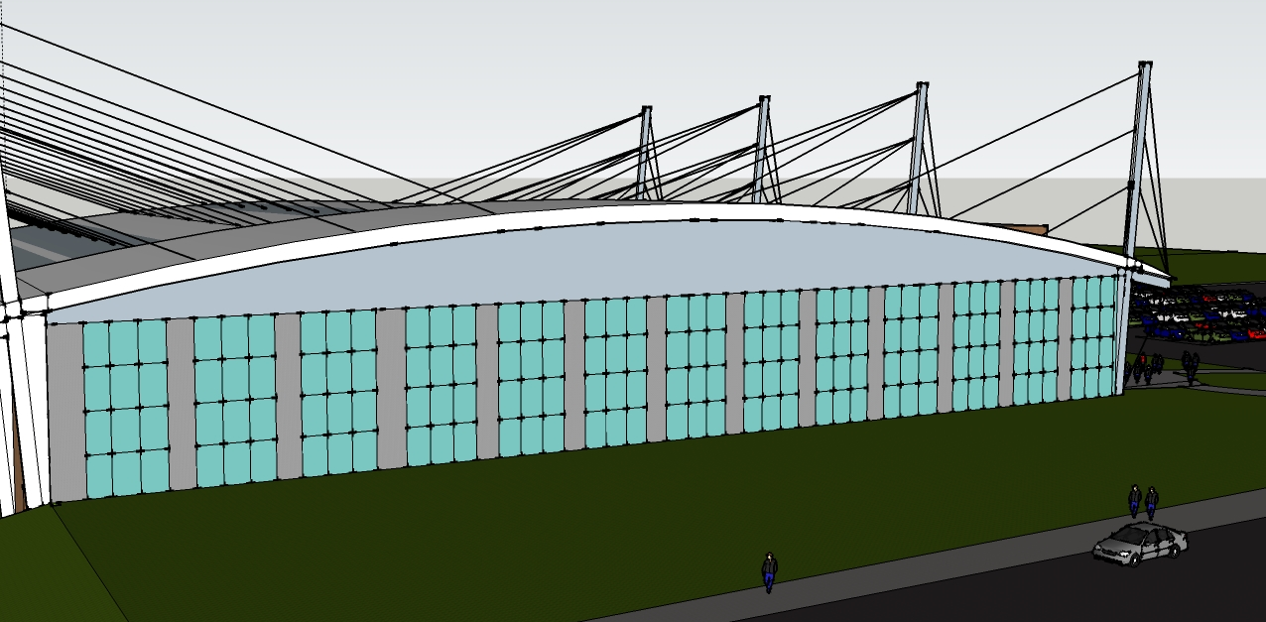
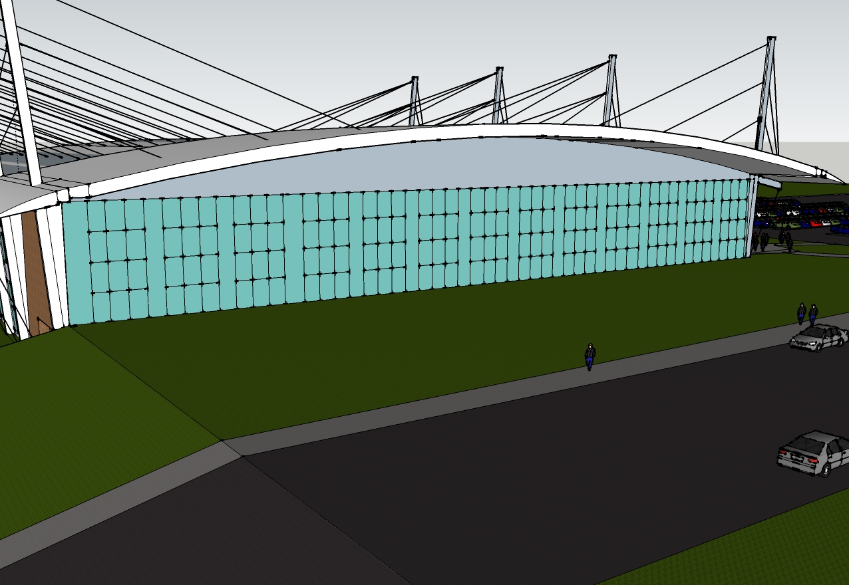
Nate Babyak Alex Ho Brian Sampson Alex Schreffler

Slide 18
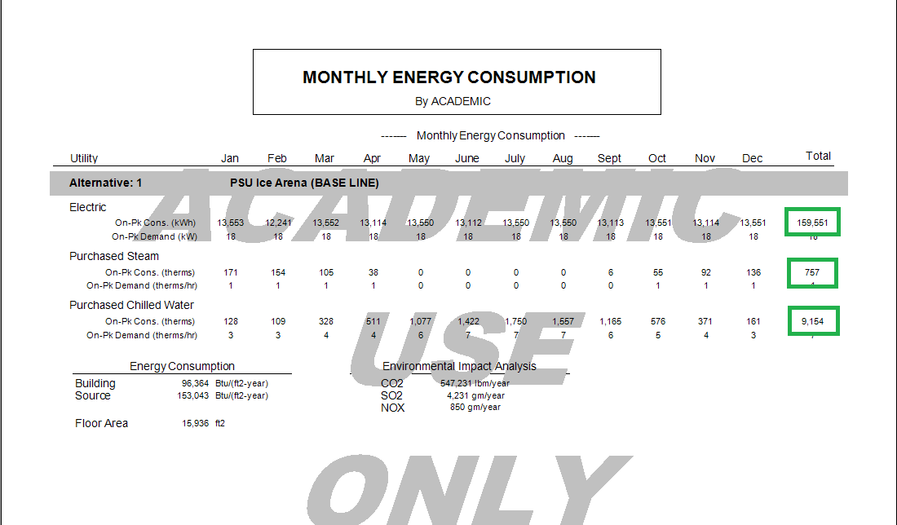
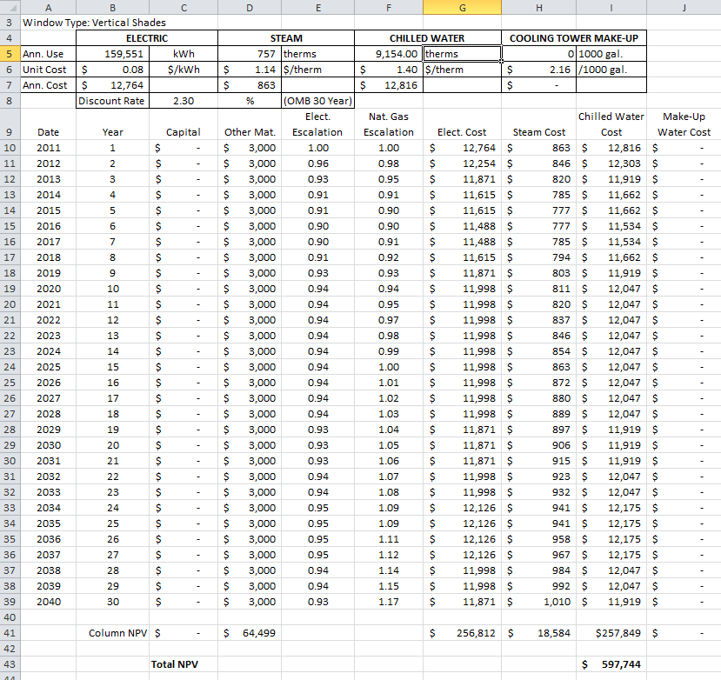
Nate Babyak Alex Ho Brian Sampson Alex Schreffler

Slide 19
Shading: Horizontal Shades
Average Illuminance Level: 225 fc
Blocks views from club level
East Façade Yearly Energy Costs: $26,443.00
Nate Babyak Alex Ho Brian Sampson Alex Schreffler

Slide 20
Shading: Overhang
Due to orientation not feasible
Requires 30’ overhang to shade morning sun
Nate Babyak Alex Ho Brian Sampson Alex Schreffler

Slide 21
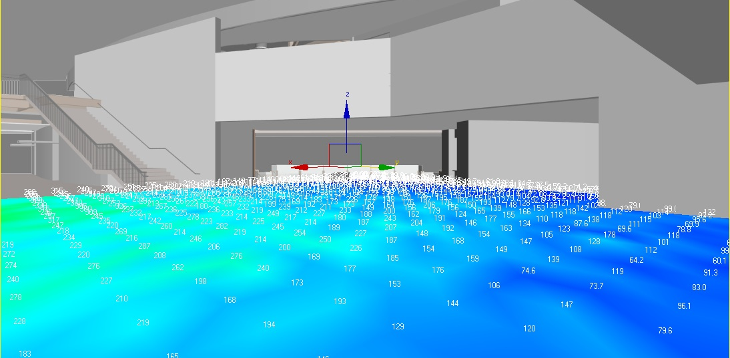
Shading: Vertical Fins
Average Illuminance Level: 200 fc
East Façade Yearly Energy Costs: $25,911.00
Nate Babyak Alex Ho Brian Sampson Alex Schreffler

Slide 22
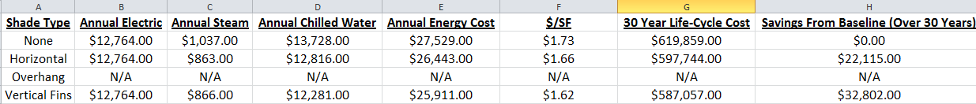
Nate Babyak Alex Ho Brian Sampson Alex Schreffler

Slide 23
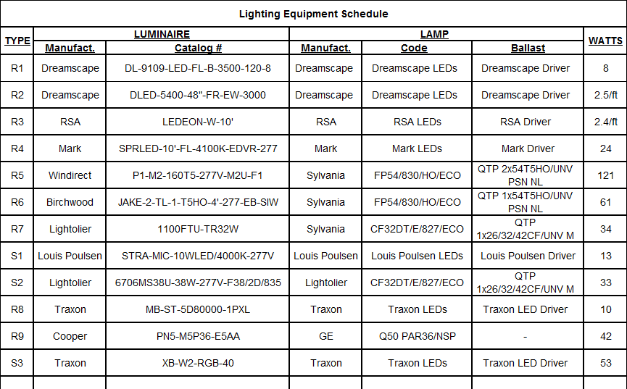
IESNA Lighting Recommendations:
  Vestibule: 30 lux
  Lobby: 100 lux
  Concourse/Circulation: 50 lux
  Club Lounge: 40 lux
  Stairs: 50 lux
ASHRAE 90.1-2010 Power Densities:
  Zone 3
  Allowable Power Density By Area: 0.78W/ft²
  By Space:
    Entry Canopy: 0.4W/ft²
    Vestibule:30W/linear feet (door width)
    Lobby: 0.9W/ft²
    Club: 1.31W/ft²
    Concourse: 1.10W/ft²
Nate Babyak Alex Ho Brian Sampson Alex Schreffler

Slide 24
Moving Forward:
Clash Detection
Building façade
Coordinate architecture
Finalize site layout
Nate Babyak Alex Ho Brian Sampson Alex Schreffler

